Slide 1



Slide 2
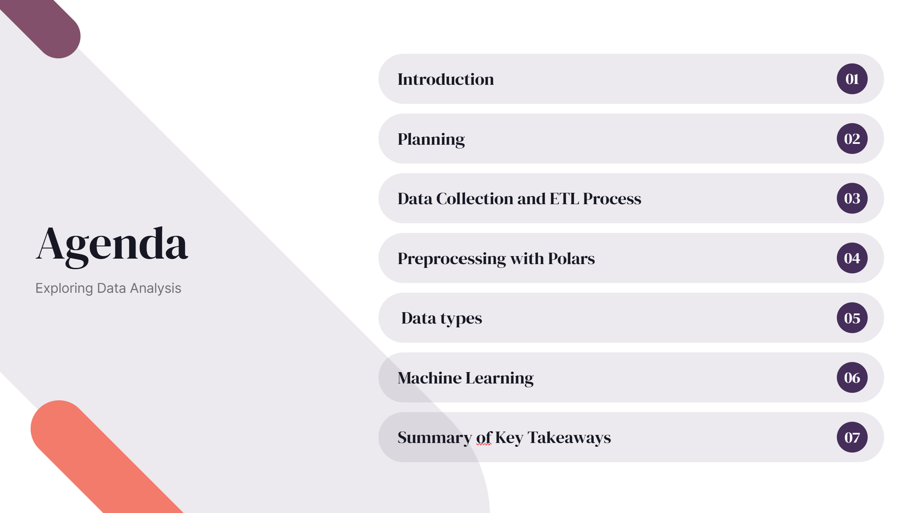

Slide 3
Introduction
In this presentation, I will explore our sales data analysis over the past year. My focus will be on understanding product purchases, sales performance, and the effectiveness of our predictive models for both short-term and long-term forecasts.
I'll start by examining the total number of products bought and sold, identifying key products, and analyzing costs and revenues. This will set the stage for a deeper dive into our data, highlighting trends and patterns influencing our sales.
Next, I will discuss the predictive modeling results using Random Forest and XGBoost. I'll compare their performance, strengths, and areas for improvement, especially for long-term forecasts.
By the end of this presentation, I aim to provide a clear understanding of our current performance and future trajectory, ensuring we are prepared to meet market demands and achieve growth.

Slide 4
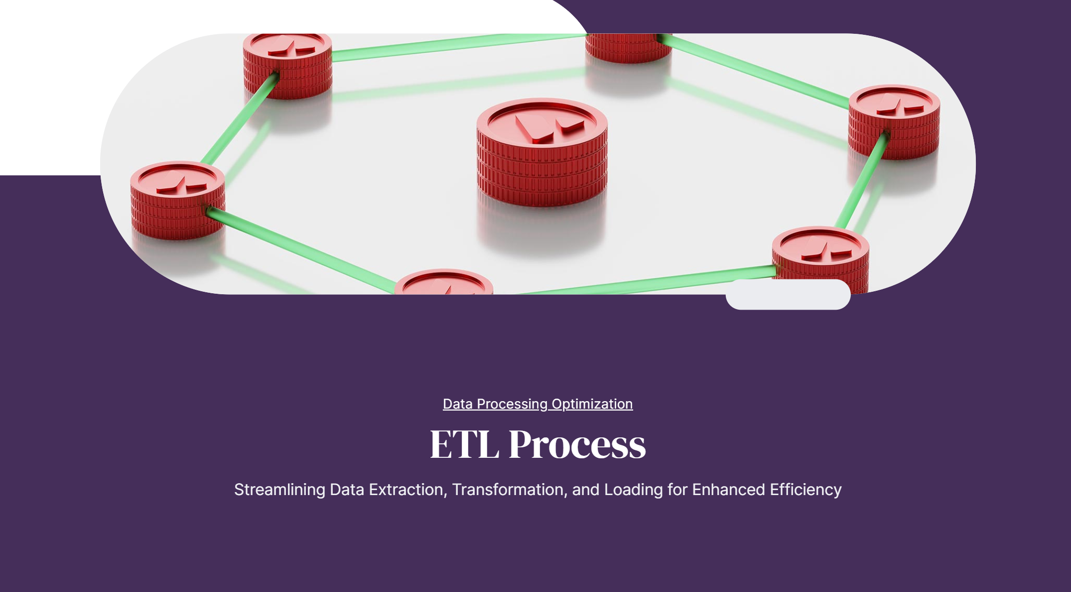

Slide 5
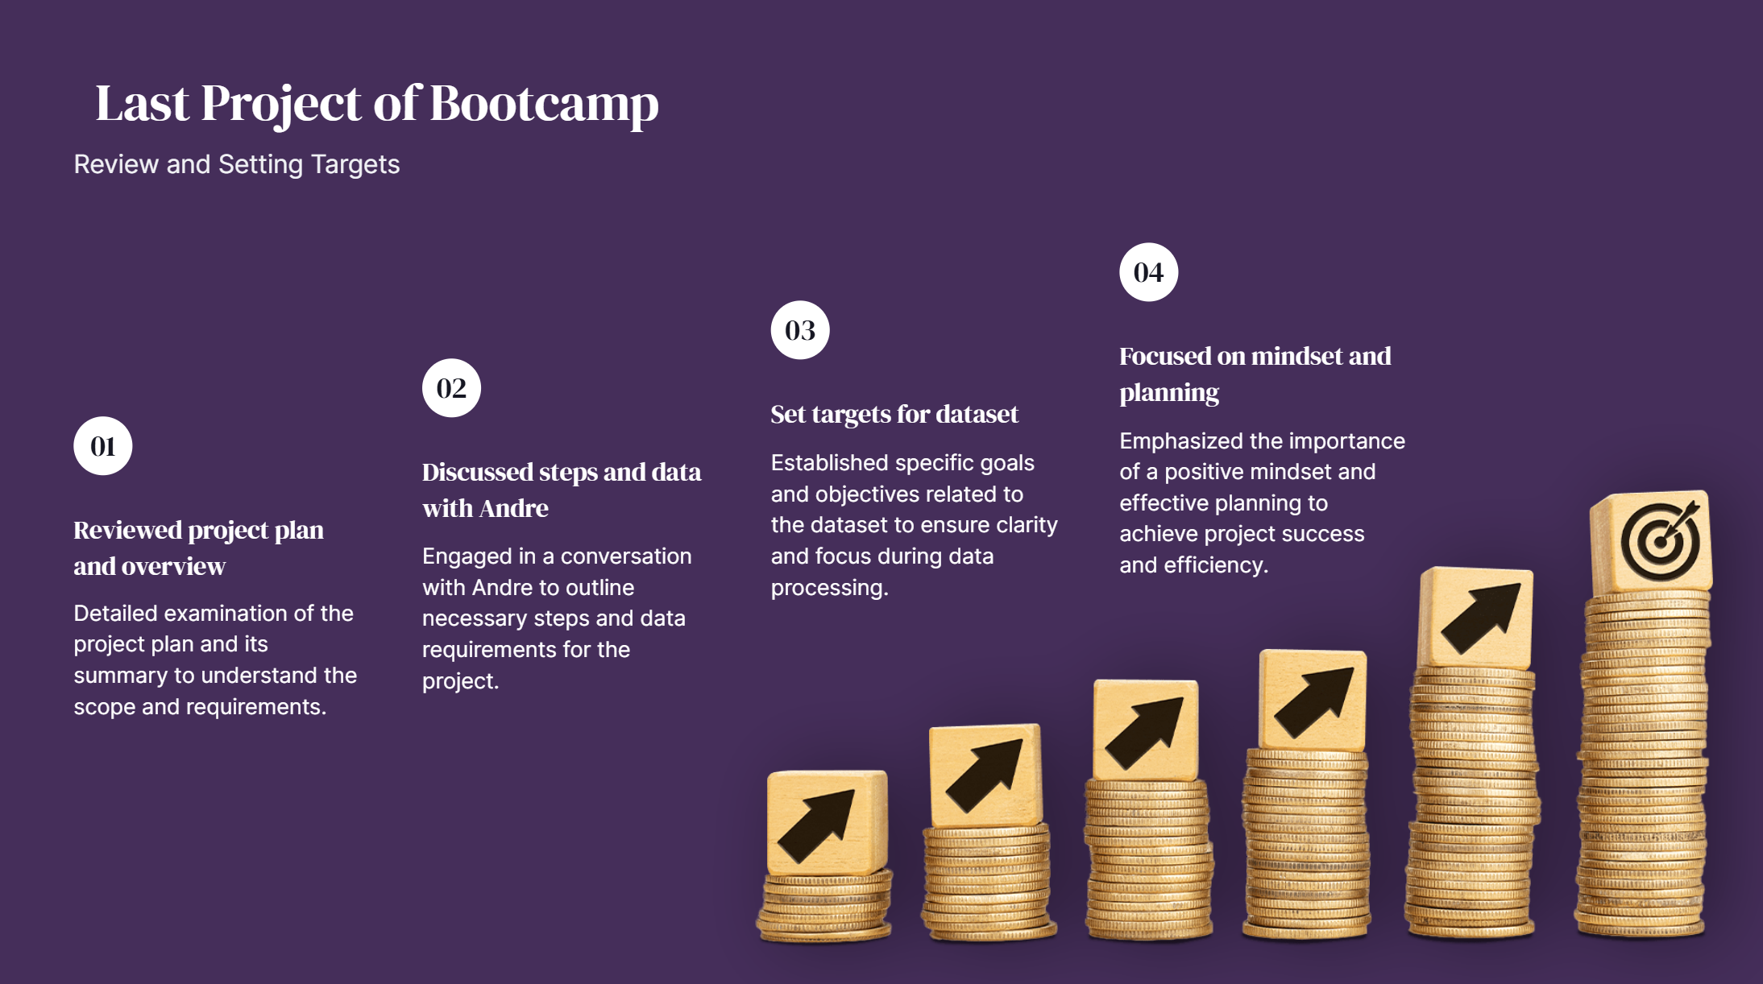

Slide 6
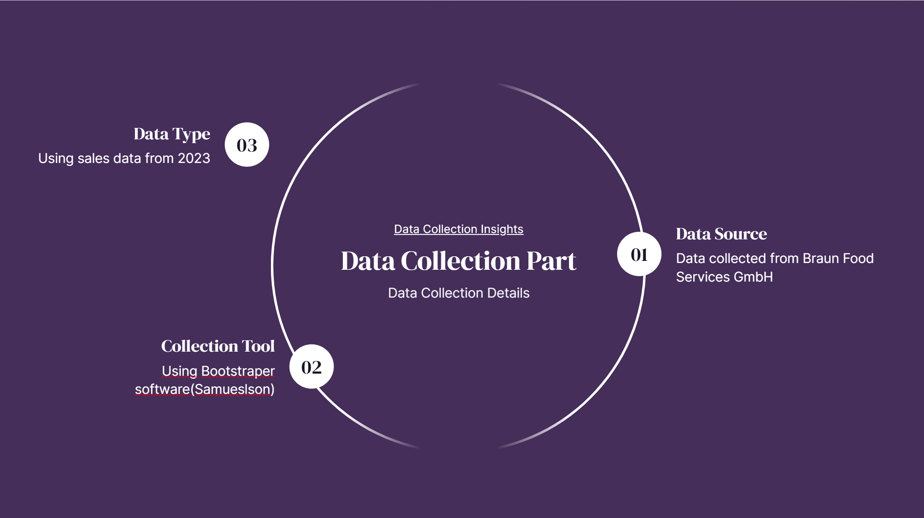
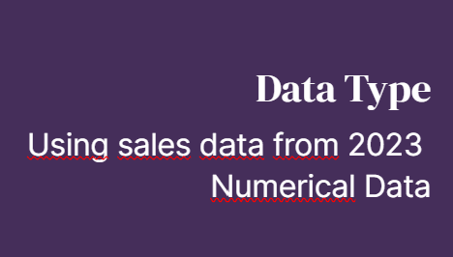

Slide 7
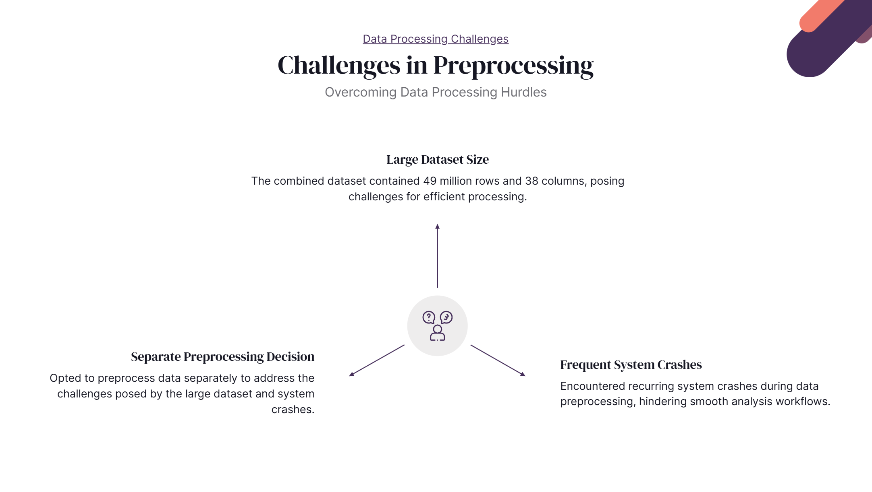

Slide 8


Slide 9
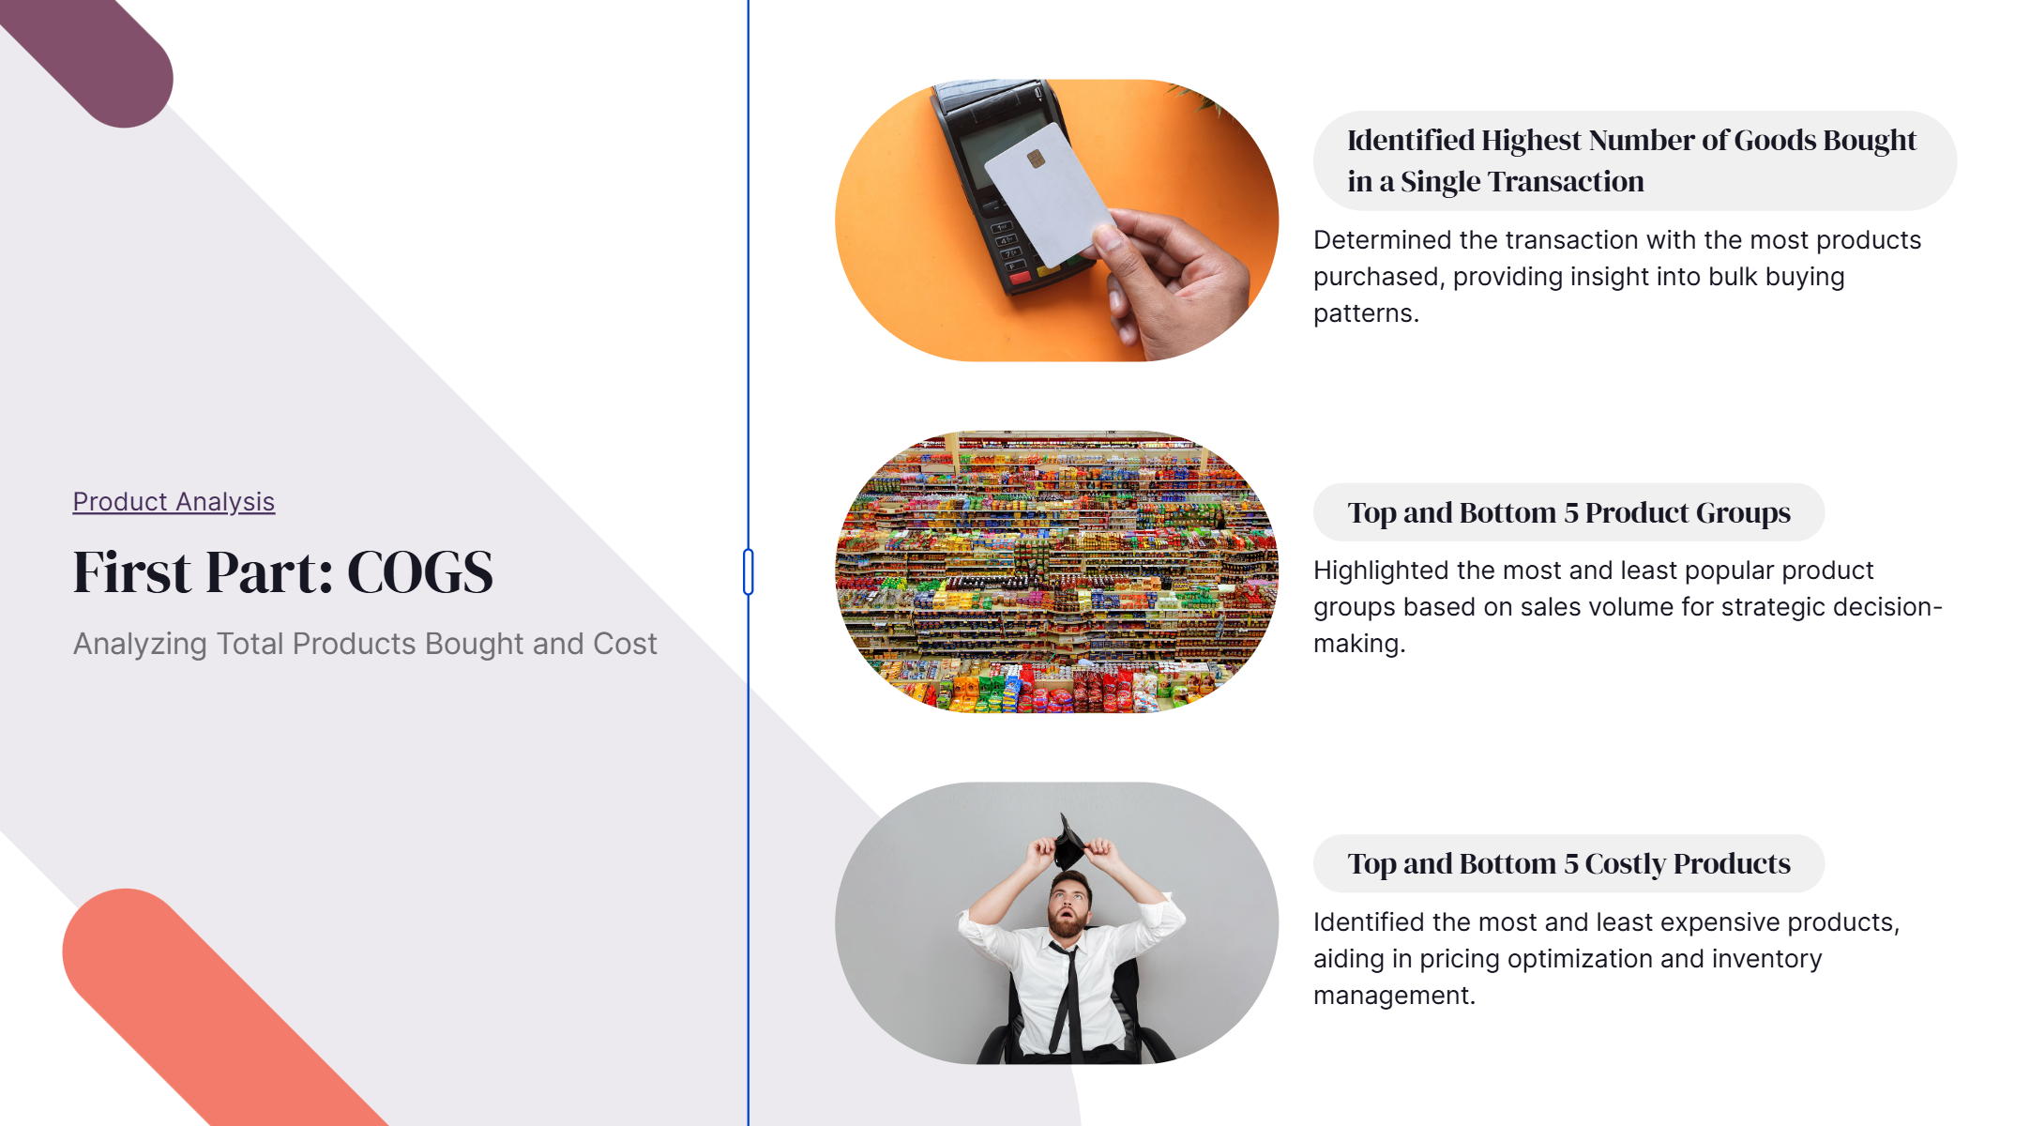

Slide 10
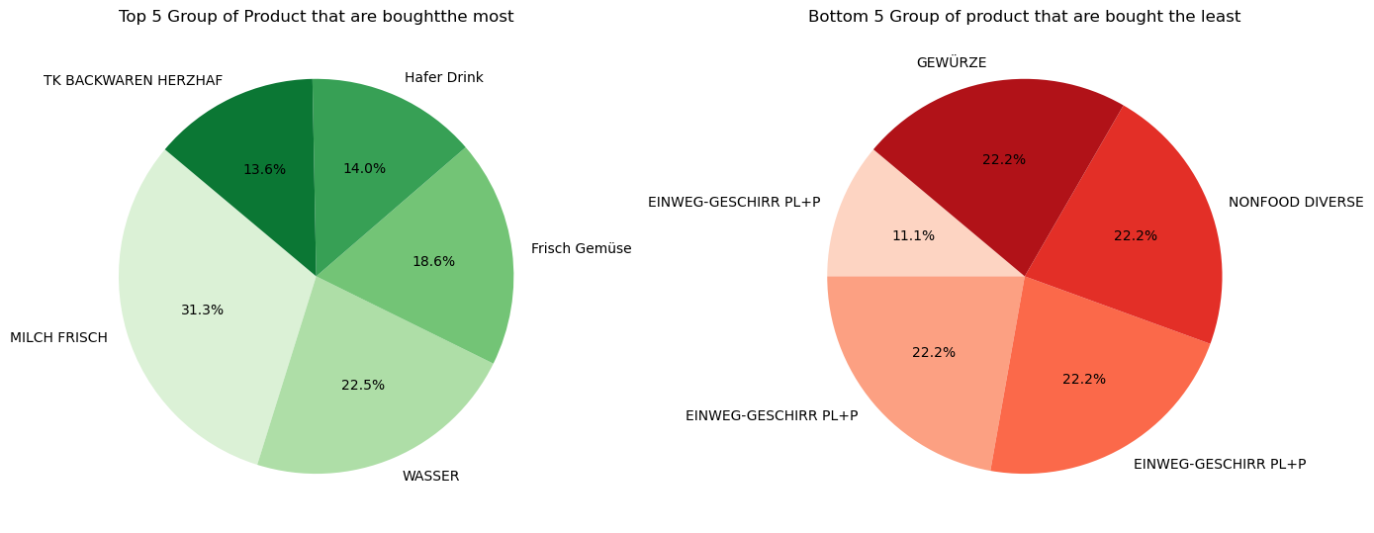
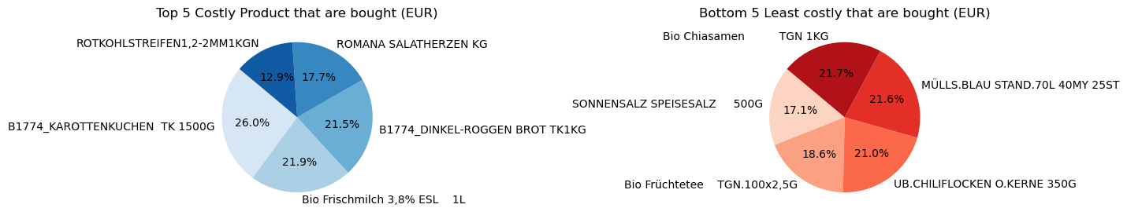

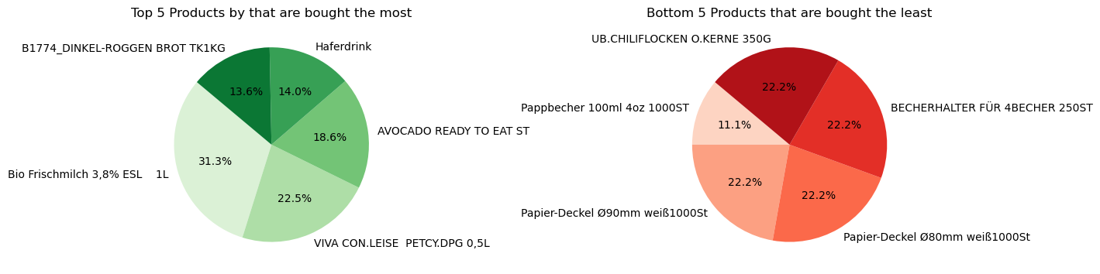
Total number of products bought :28313.0
Total cost in Euro (EUR): 256603.69999999987€
The Product that we bought in whole year is
Bio Frischmilch 3,8% ESL 1L Taotal=3360.0 , taht cost= 5617.3 €

Slide 11
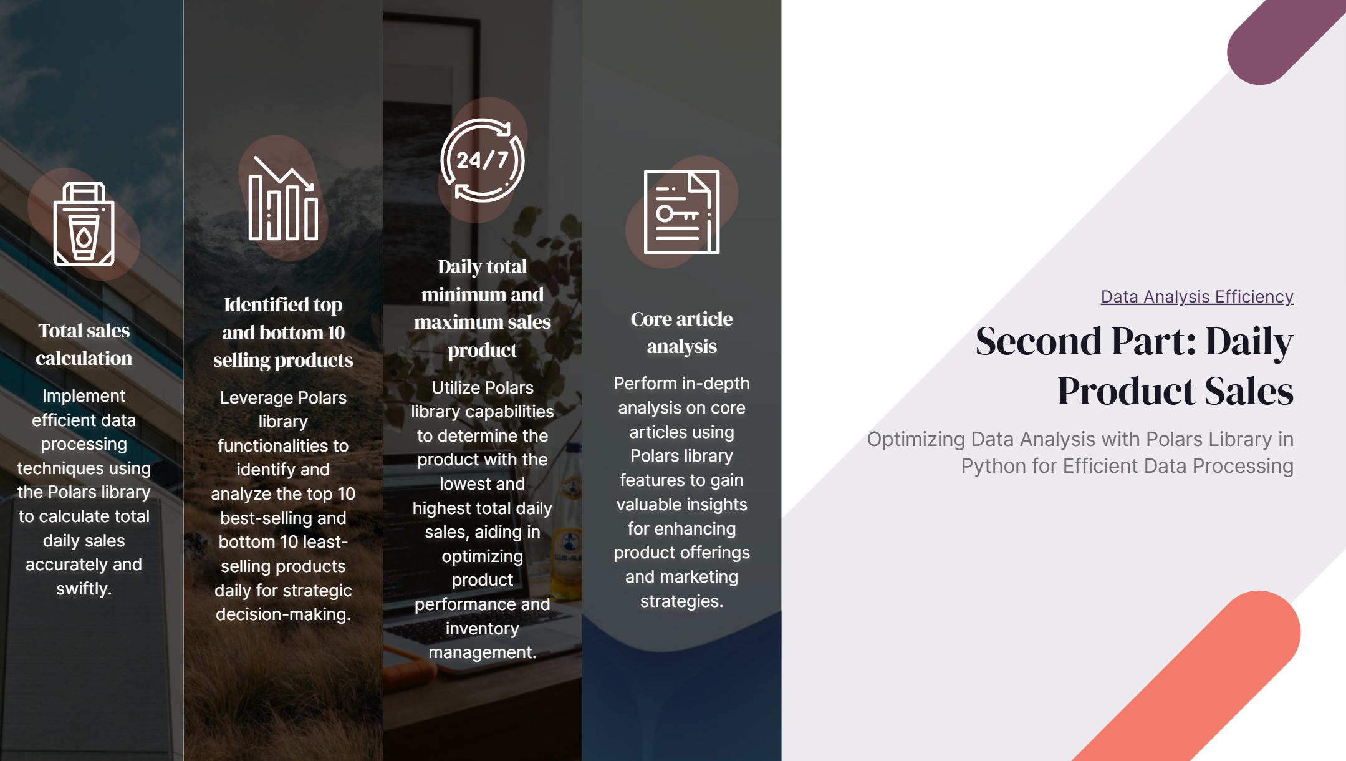

Slide 12
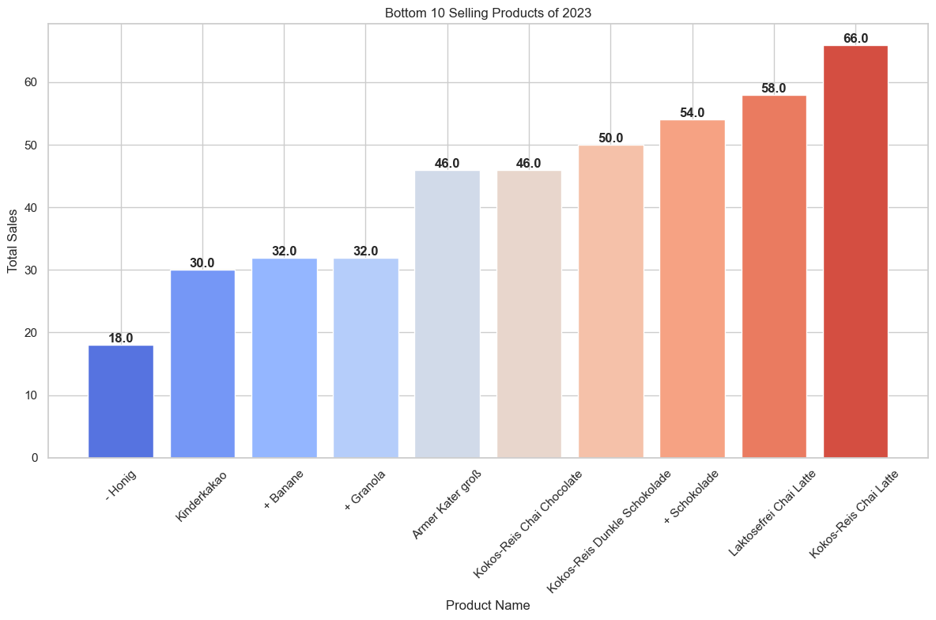
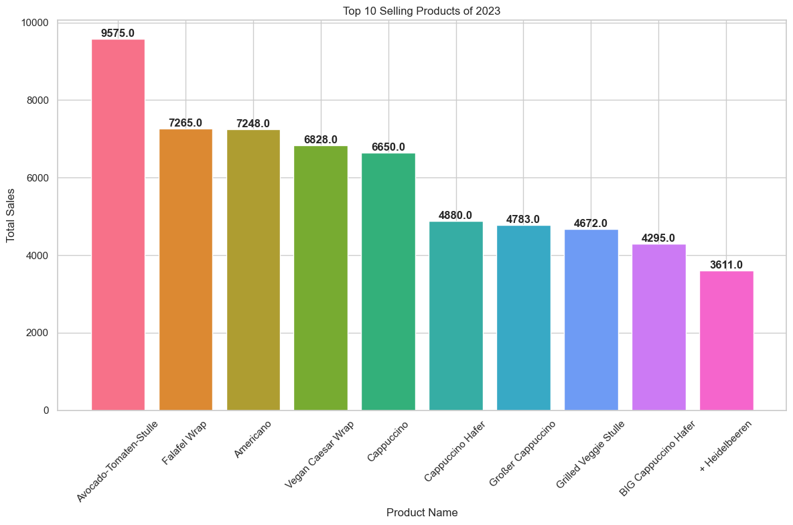
Total products sold: 130119.0

Slide 13
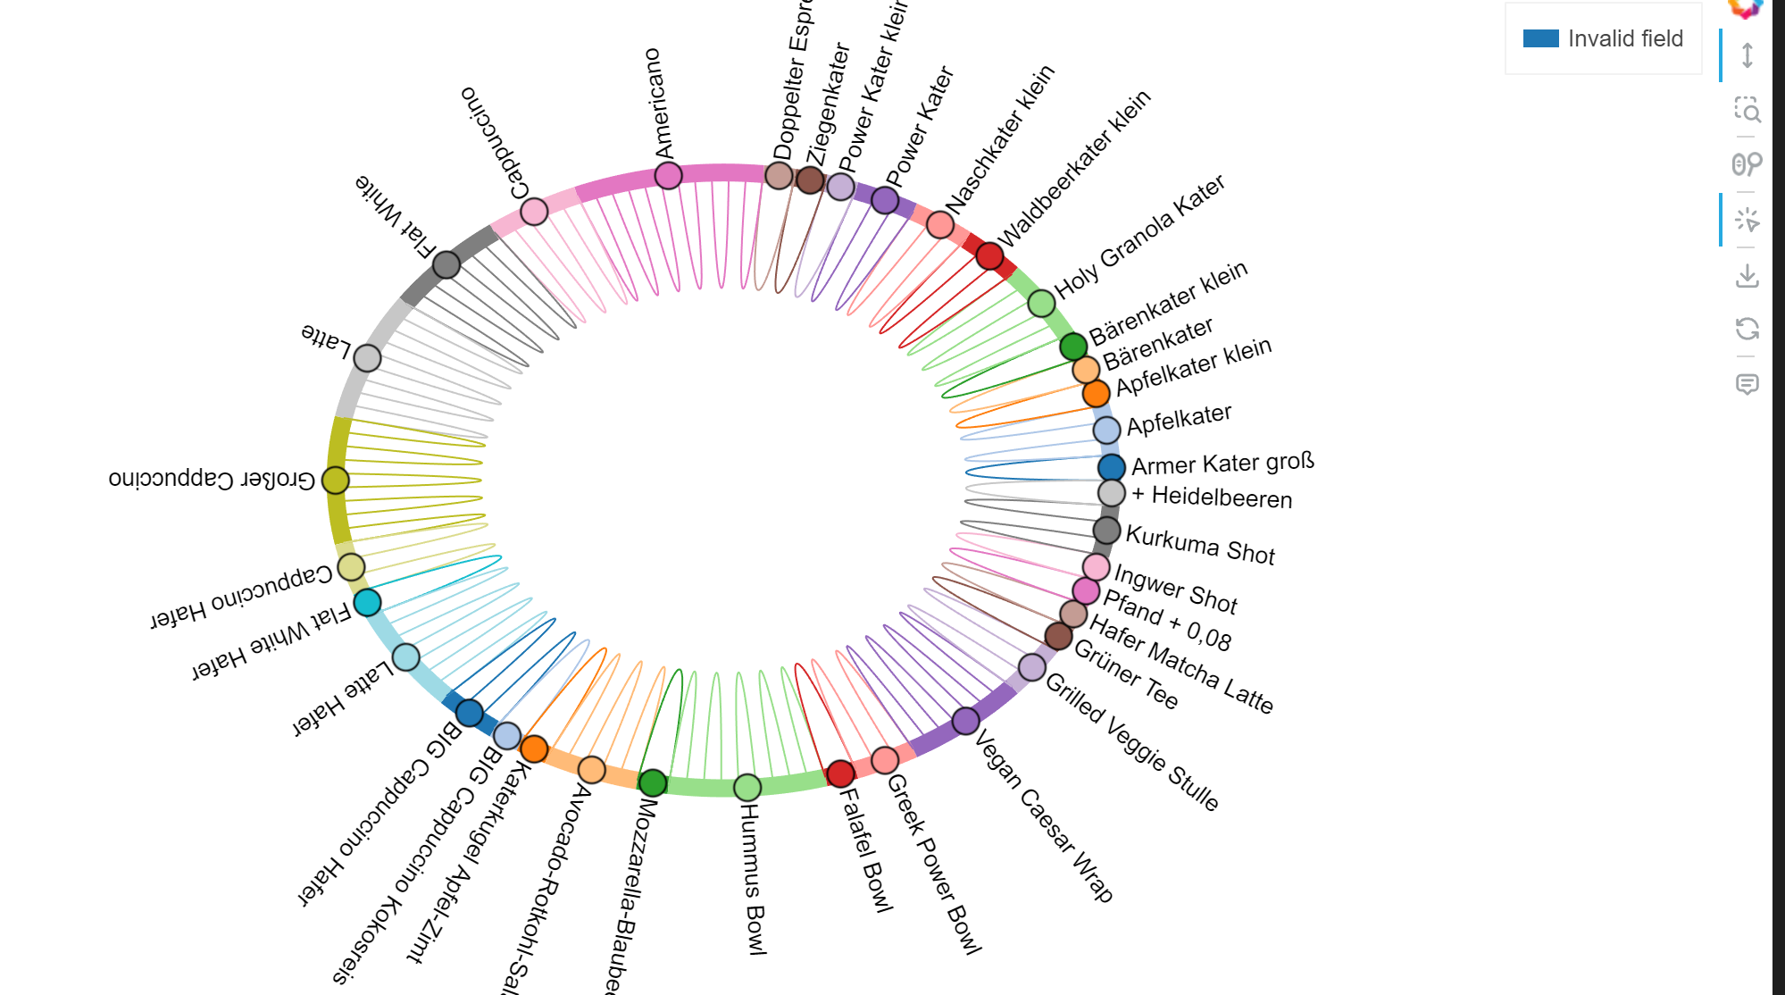
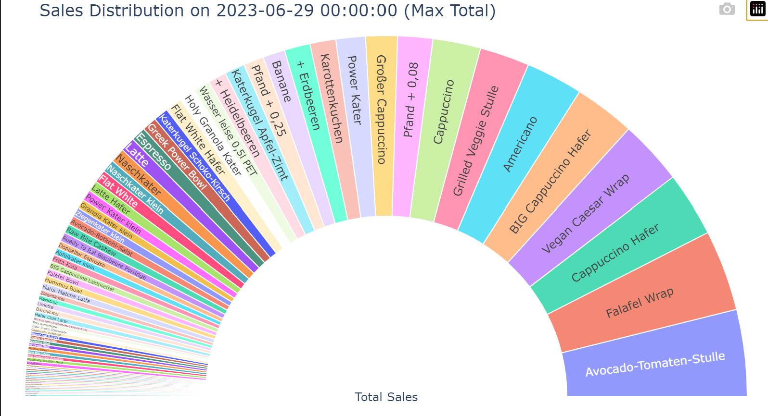
Overview of all products What we sell on Most selling day and Less selling Day
Date: 2023-03-27, Total Sales-Lowest Product sales 77.0

Slide 14
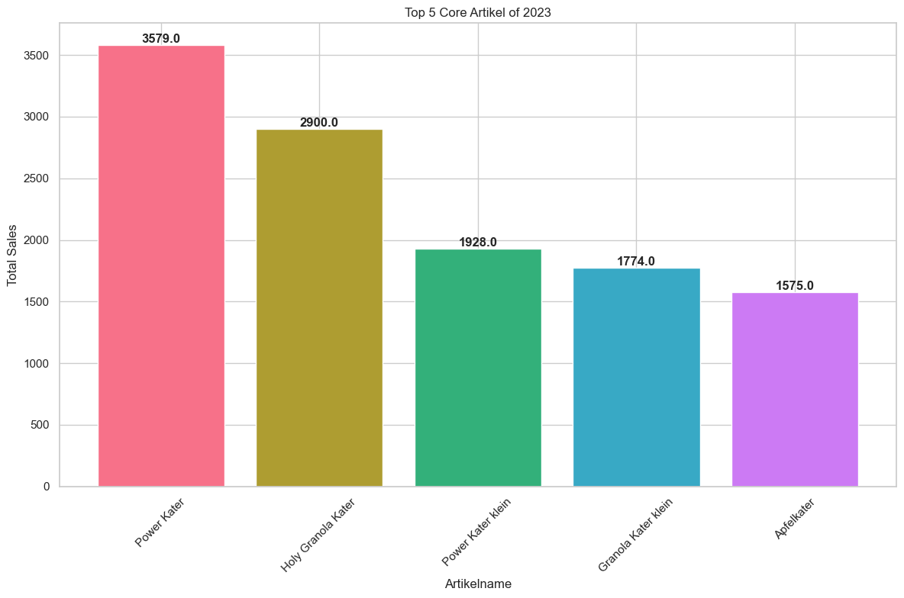
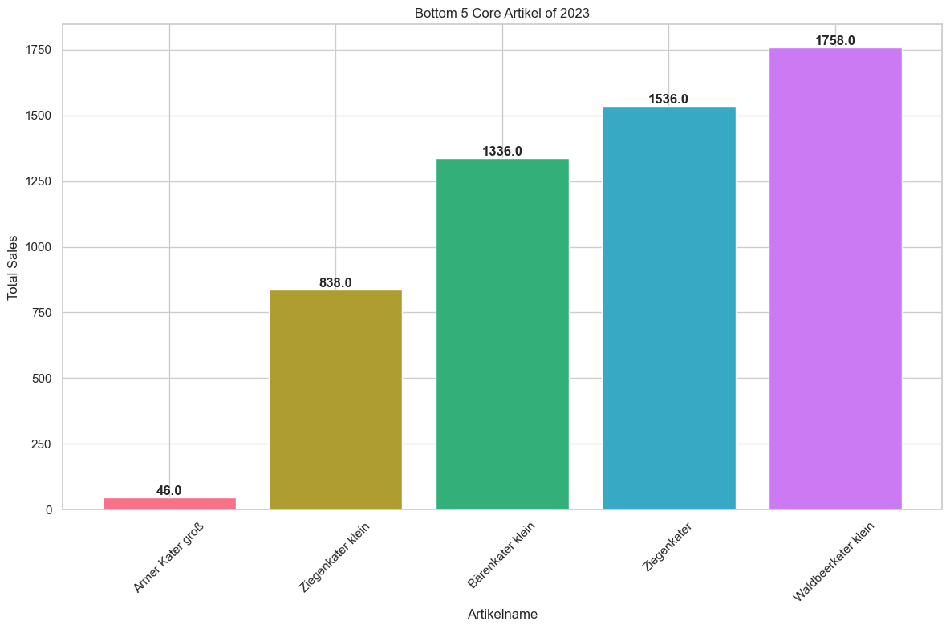
Core Artikel Overview

Slide 15


Slide 16
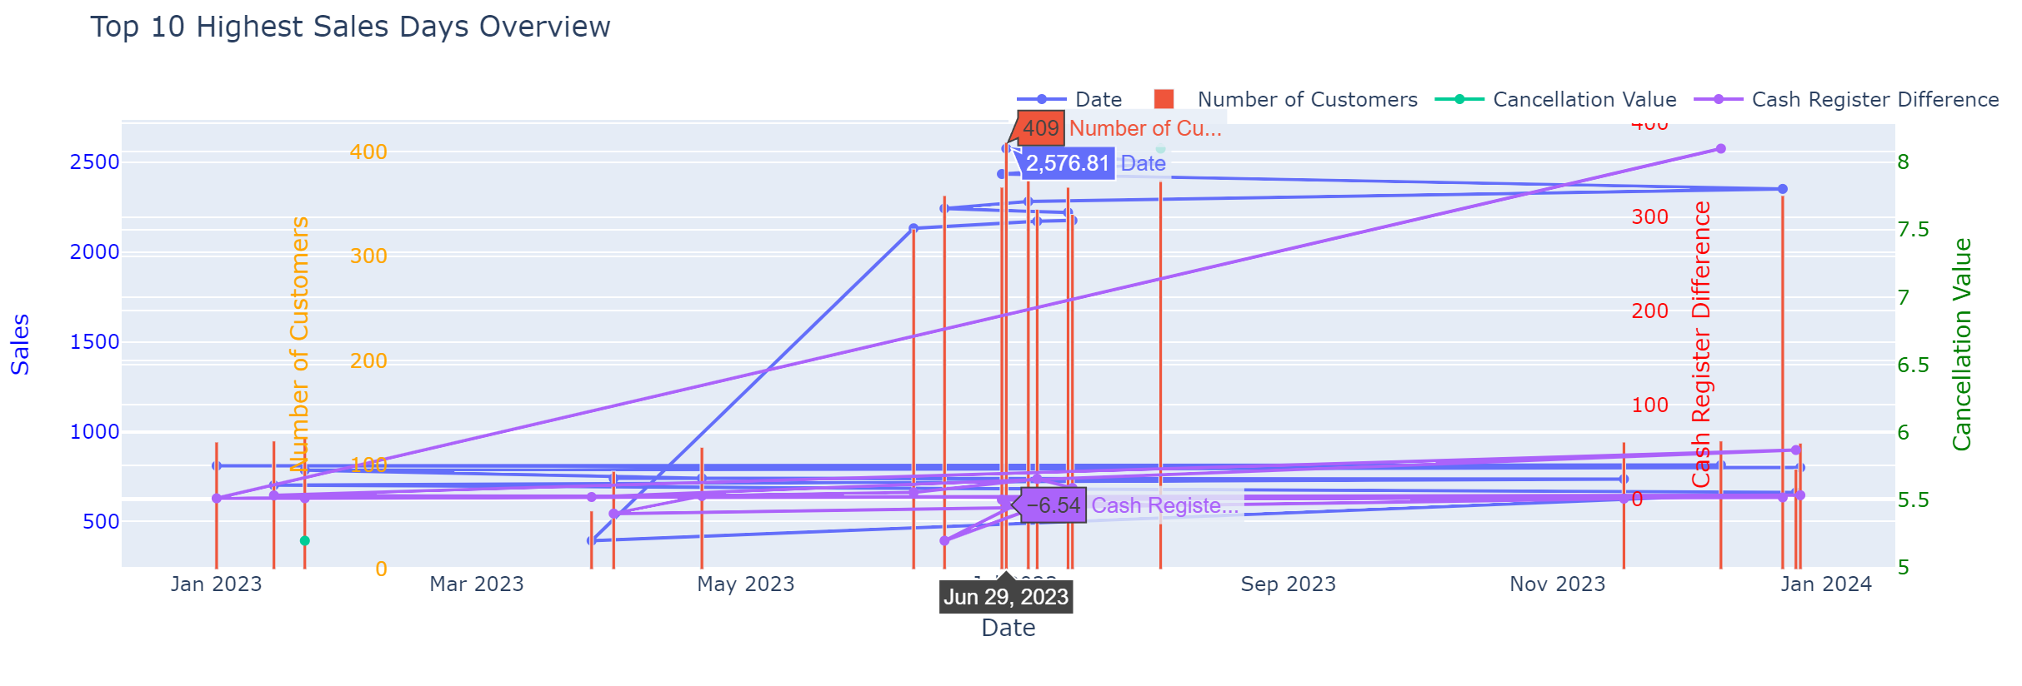
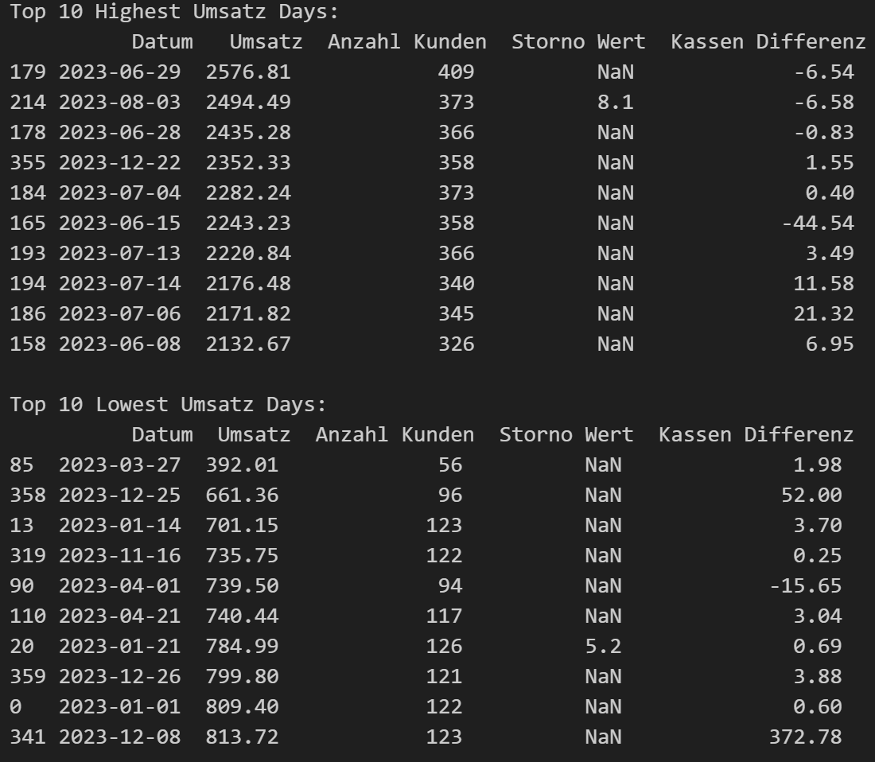
Notes:
Breaking down customer segments and their purchase behavior helps us tailor marketing strategies to different groups, enhancing our ability to meet their needs.

Slide 17
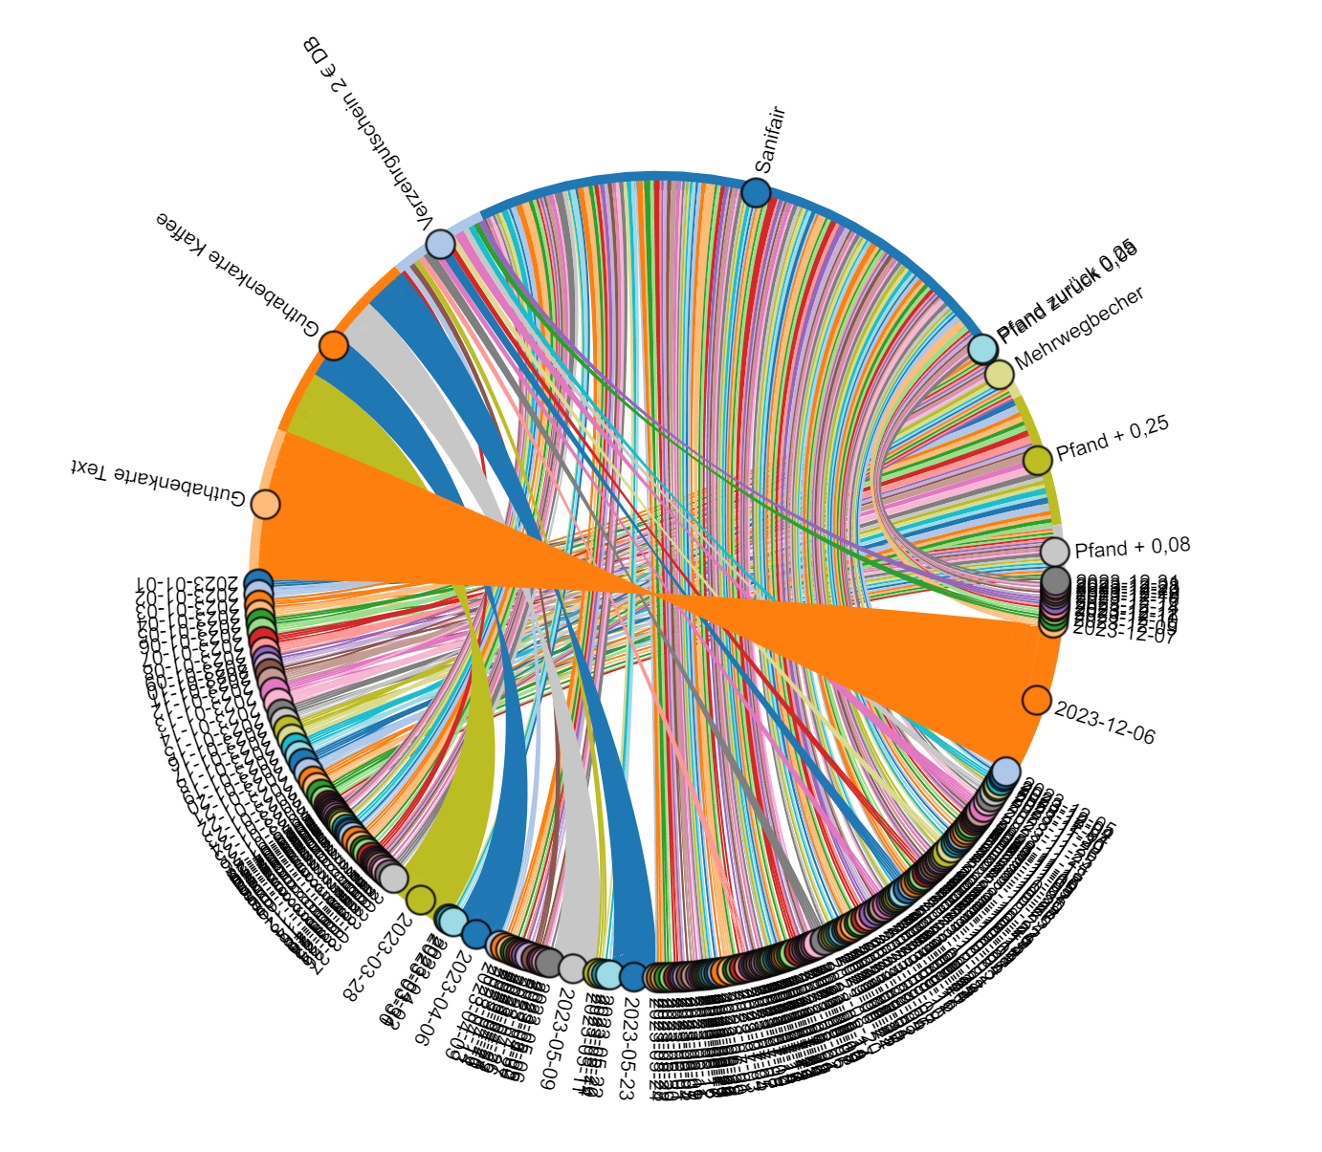
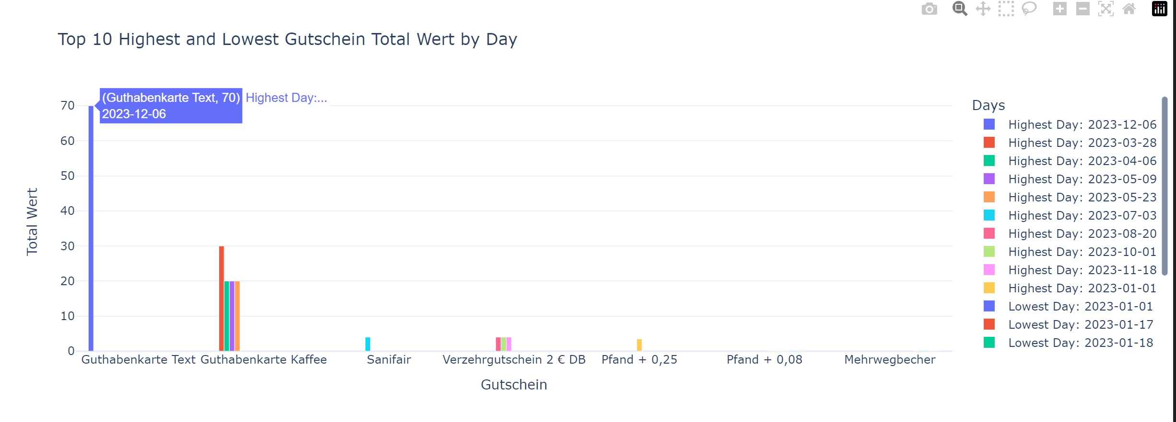

Voucher and Discount

Slide 18
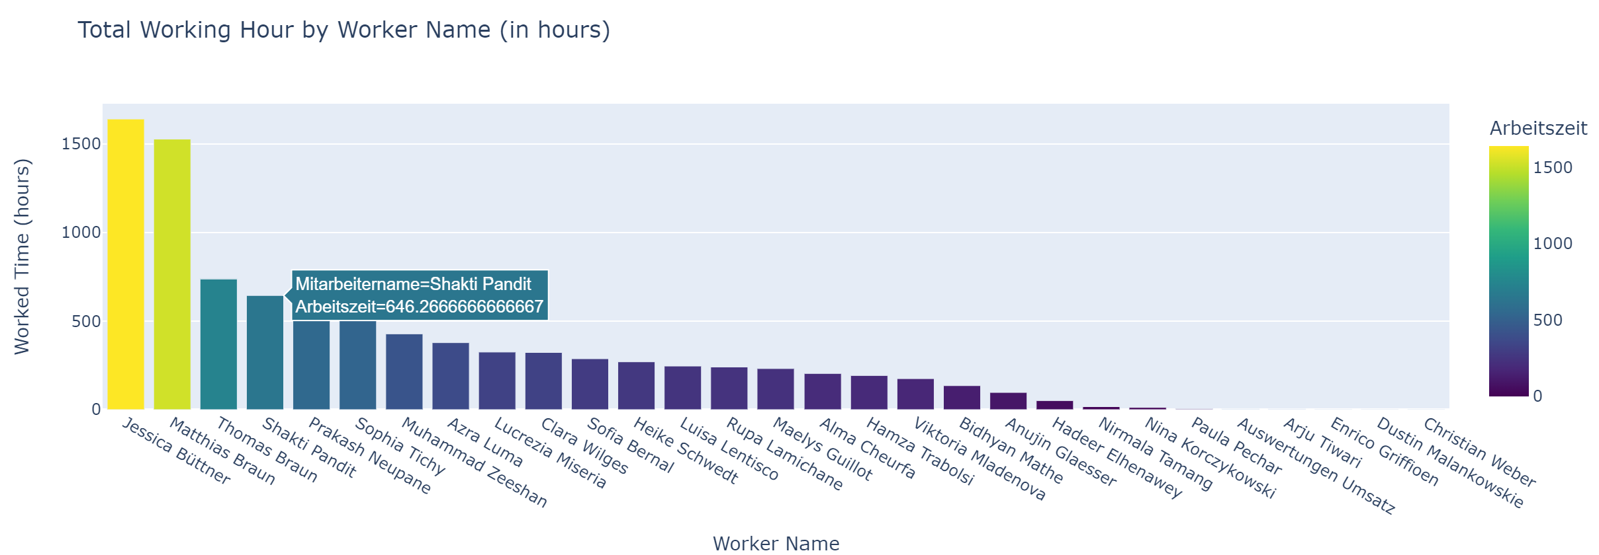
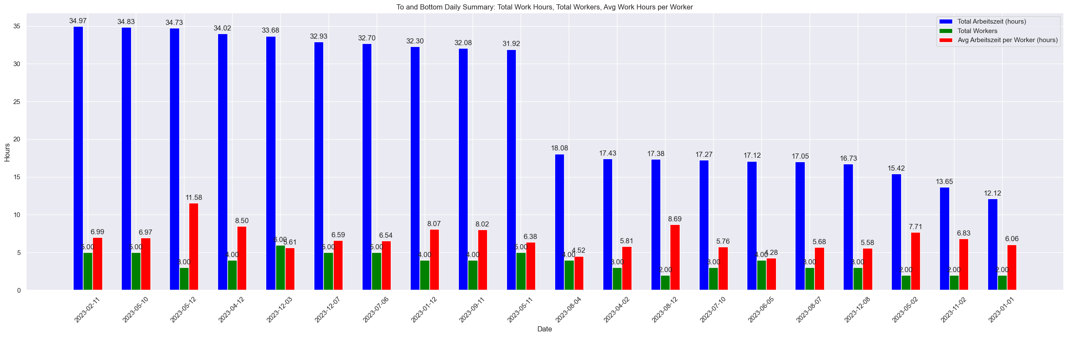

Slide 19
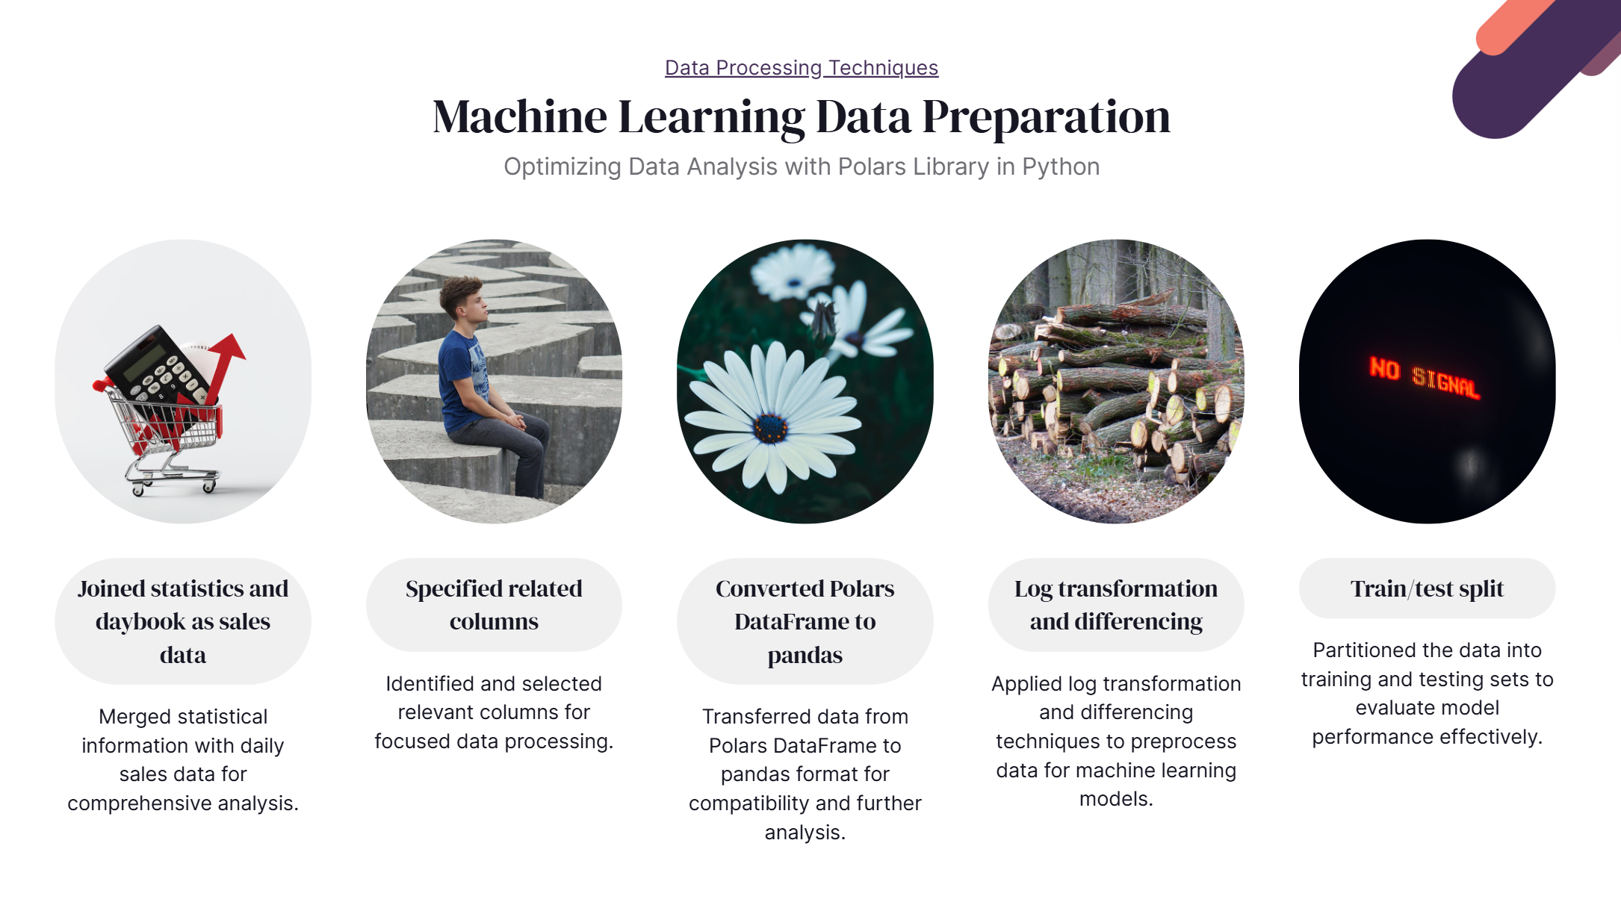

Slide 20
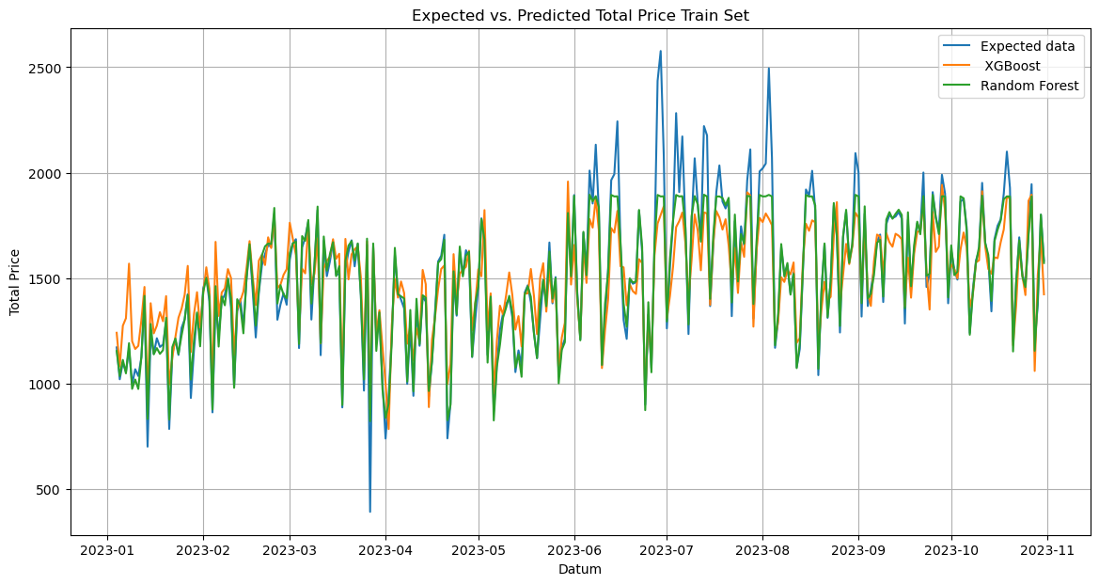
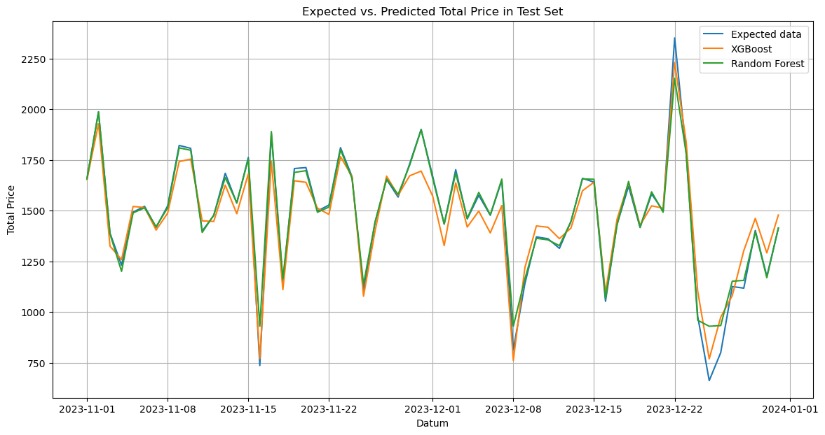
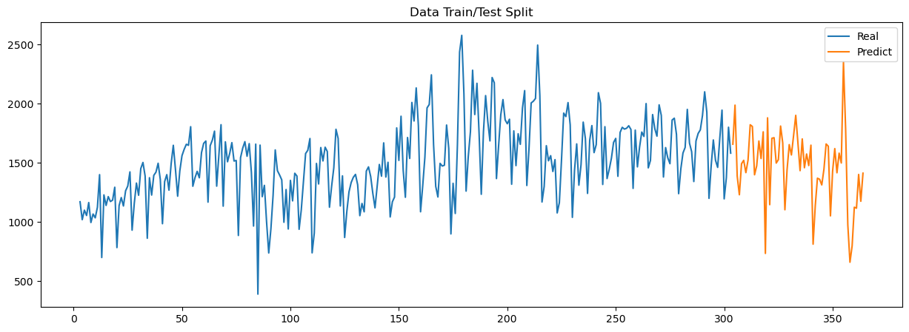
Train Set- RF Mean Absolute Error: 44.644342782392926 Mean Squared Error: 8674.668270926055 Root Mean Squared Error: 93.13789921898633 R2: 0.9217708029531051
Train Set- xgb Mean Absolute Error: 115.76091774975477 Mean Squared Error: 24437.789745995804 Root Mean Squared Error: 156.32590874834474 R2: 0.9217708029531051
Test Set - RF Mean Absolute Error: 24.07445331967222 Mean Squared Error: 3119.364247784349 Root Mean Squared Error: 55.85126898991955 R2: 0.9673964252925705Test
Set- xgb
Mean Absolute Error: 59.86261690733951 Mean Squared Error: 5516.31688570701 Root Mean Squared Error: 74.27191182208124 R2: 0.9673964252925705

Slide 21
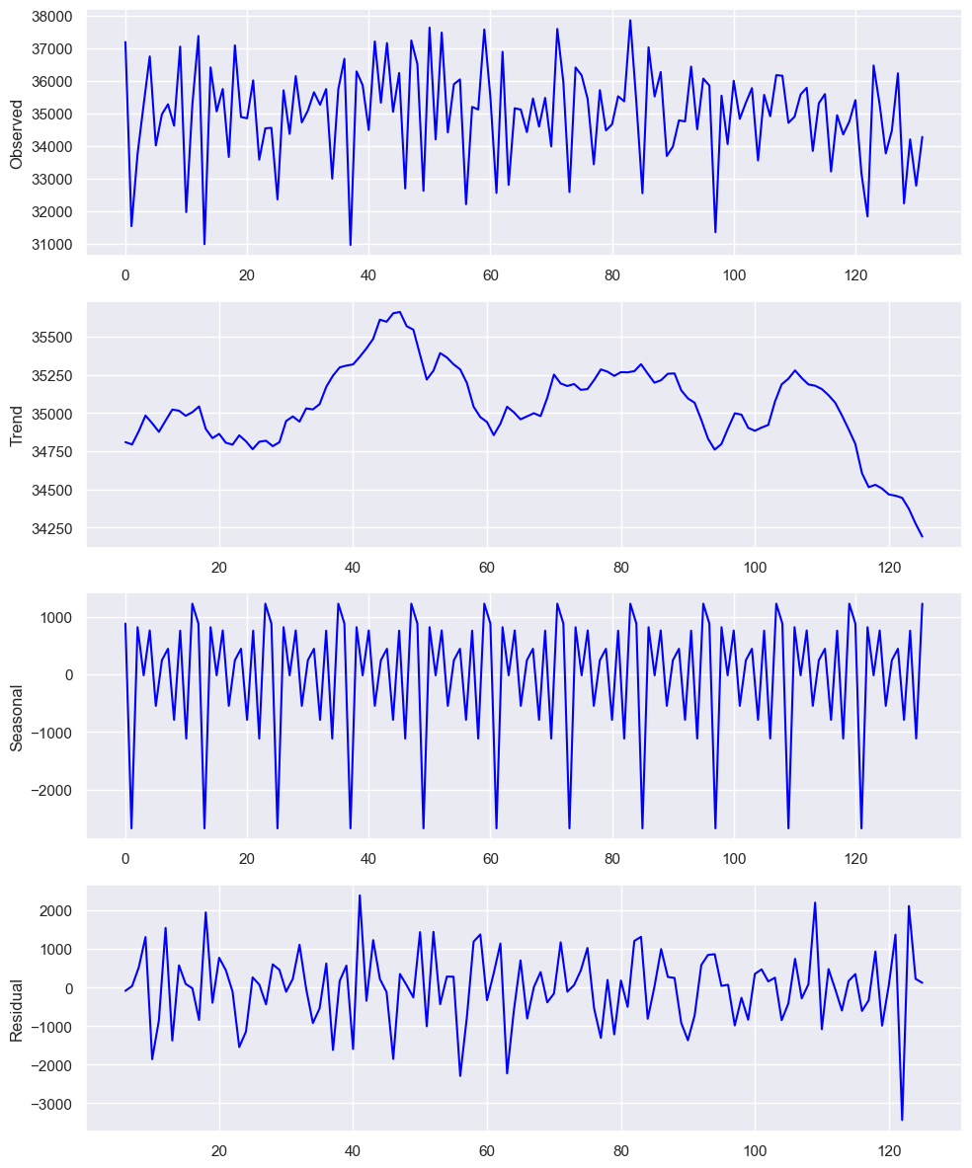
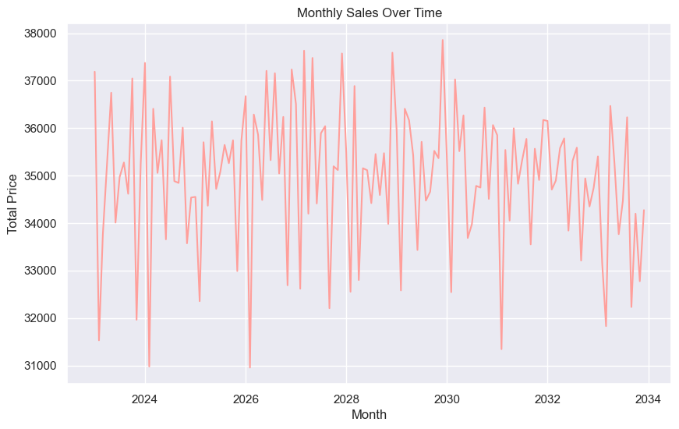
Prediction for the upcoming 10 years

Slide 22
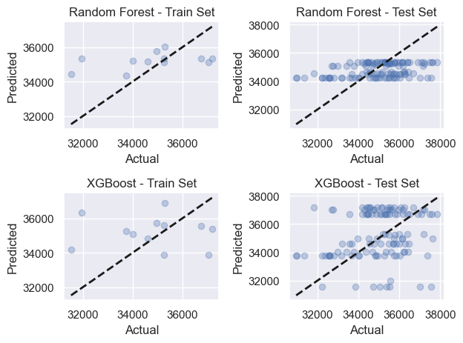
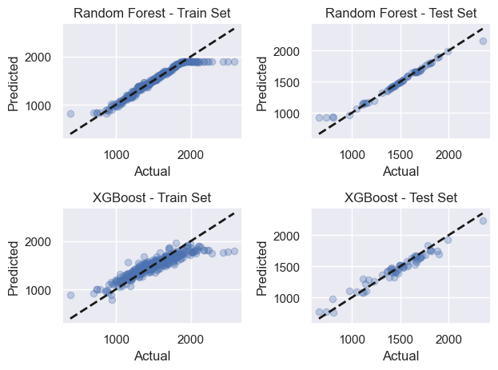
10 years Of Prediction
12 Month of Prediction
Train Set- RF Mean Absolute Error: 1302.206086967886
Mean Squared Error: 2693844.6417117473
Root Mean Squared Error: 1641.2935879091672
R2: 0.09476135049642631
Train Set- xgb
Mean Absolute Error: 1664.9609691169392
Mean Squared Error: 4089858.181808919
Root Mean Squared Error: 2022.339779020558
R2: -0.37435457109705483
Train Set- RF Mean Absolute Error: 44.644342782392926 Mean Squared Error: 8674.668270926055 Root Mean Squared Error: 93.13789921898633 R2: 0.9217708029531051
Test Set - RF Mean Absolute Error: 24.07445331967222 Mean Squared Error: 3119.364247784349 Root Mean Squared Error: 55.85126898991955 R2: 0.9673964252925705Test
Test Set - RF
Mean Absolute Error: 1125.6456814200171
Mean Squared Error: 1928496.9761878198
Root Mean Squared Error: 1388.7033434783039
R2: 0.0968242893305391
Test Set- xgb Mean Absolute Error: 1607.4235575413234
Mean Squared Error: 3956117.9106667596
Root Mean Squared Error: 1988.9992233952128
R2: 0.0968242893305391
Train Set- xgb Mean Absolute Error: 115.76091774975477 Mean Squared Error: 24437.789745995804 Root Mean Squared Error: 156.32590874834474 R2: 0.9217708029531051
Test Set- xgb Mean Absolute Error: 59.86261690733951 Mean Squared Error: 5516.31688570701 Root Mean Squared Error: 74.27191182208124 R2: 0.9673964252925705

Slide 23

Conclusion
our analysis has provided valuable insights into our sales data and the performance of our predictive models:
Short-Term Predictions (12 Months):
Both Random Forest and XGBoost models have demonstrated high accuracy and low overfitting, making them suitable for short-term sales forecasting.
Long-Term Predictions (10 Years):
Both models face challenges with increased variability and uncertainty over the long term. While XGBoost shows a slightly better generalization, there is still room for improvement.
Overfitting is more pronounced, indicating the need for careful tuning and potentially additional data to enhance long-term forecasting.
Next Steps:
Model Improvement: To address the long-term prediction challenges, we plan to gather more comprehensive data and explore advanced techniques like ensemble learning and hybrid models.
Operational Changes: Implementing these models into our inventory and sales strategies will require some operational adjustments, including more dynamic stocking procedures and refined promotional strategies based on predicted trends.
Continuous Monitoring: Regularly monitoring model performance and adjusting parameters will be crucial to maintaining accuracy over time.
These findings will guide our future strategies in inventory management and sales forecasting, ensuring we stay ahead of market trends and demands.

